Slide 1
Procedures and Functions

Slide 2
Objectives
At the end of this session, participants will be able to:
Understand what are PLSQL subprograms and their need
Comprehend the difference between stored and unstored subprograms
Create and drop stored procedures and functions
Apply different parameter modes in subprograms
Understand and use procedures and functions that are local to a stored subprogram
Understand the different data dictionary views

Slide 3
Agenda
Need for subprograms
Creating & invoking Stored Procedures
RAISE_APPLICATION_ERROR procedure
Creating & invoking Stored Functions
Local Procedures and Functions within a stored subprogram
Parameter passing mechanisms
Privileges related to functions and procedures
Dropping procedures and functions
Data dictionary views related to subprograms

Slide 4
Need for subprograms
A subprogram is a program unit that performs a particular task.
Subprograms offer all features of modular programming.
Unlike PL/SQL anonymous blocks, a subprogram can be invoked by another subprogram or program, called as calling unit.

Slide 5
Subprograms in PL/SQL
Are named PL/SQL blocks that can be invoked with a set of parameters.
Types of PLSQL subprograms:
      Procedures
      Functions
      Packages
      Triggers
A subprogram can be created:
      At schema level
      Inside a package
      Inside a PL/SQL block
Procedures and Functions behave similar to procedures of other 3GLs
Notes:
Performance of a Subprogram and Anonymous block
Every time an Anonymous block is to be executed, it’s code must be reloaded. It is first compiled and then executed. An anonymous block is not stored in the database and cannot be called from other PL/SQL blocks.
Where as code for a subprogram is stored in the database in the compiled form and when the subprogram is called, the compiled code is executed directly. Thus as compared to an equivalent anonymous block its execution is faster as it saves on compilation time.
Types of Sub programs
Functions: These subprograms return a single value, mainly used to compute and return a value
Procedures: These subprograms do not return a value directly, mainly used to perform an action.

Slide 6
Creating a Procedure
Stored Procedure
  A stored procedure is a named PL/SQL block that performs an action. It can be stored in the database as a database object for repeated execution.
Syntax
  CREATE [ OR REPLACE ] PROCEDURE proc_name[(argument [mode] data_type,
  argument [mode] data_type,……)]
  -- PROCEDURES may or may not accept arguments
    IS
    -- Local PL/SQL variable declarations
    BEGIN
    -- Define action performed by the
    -- procedure
    EXCEPTION
    -- Handle exceptions, if any
    END [ proc_name];
Notes:
Advantage of Replace option
This option replaces the previous definition of the FUNCTION, PROCEDURE ,PACKAGE in the schema with the same name. The advantage of using the “REPLACE” option over “Dropping and recreating an object with new definition” is that the object privileges granted on the object get automatically revoked when you drop the object and are to be explicitly granted again when you recreate it with the new definition where as when the REPLACE option is used the object privileges remain unchanged.
proc_name : Name of the procedure
argument : Name of the PL/SQL variable whose value is passed to, populated by the
calling environment or both , depending on the mode being used.
mode : Mode of the argument IN , OUT or IN OUT (explained later)
datatype : Datatype of the argument
The REPLACE option indicates that if the procedure exist it’s definition will be overwritten by a new procedure body.
Eg # 1
CREATE OR REPLACE PROCEDURE raise_salary
(p_eno emp.empno%TYPE)
IS
BEGIN
UPDATE emp
SET sal = sal * 0.1
WHERE empno = p_eno;
END raise_salary;

Slide 7
Parameters Modes in Procedures and Functions
Formal parameters can have three modes IN, OUT or IN OUT which decides the behavior of parameters
IN
OUT
IN OUT
Default parameter mode
Must be specified
Must be specified
Value is passed into subprograms
Value is returned to the calling environment
Value is passed into subprogram and formatted value is returned to the calling environment
Formal parameter acts as a constant inside a subprogram
Formal parameter acts as a uninitialized variable
Formal parameter acts as a initialized variable
Actual parameter can be an expression, constant or initialized variable
Actual parameter must be a variable
Actual parameter must be a variable

Slide 8
IN Parameter: Example
CREATE OR REPLACE PROCEDURE count_by_status
(p_status IN service_request.status%TYPE)
IS
v_cntRequest NUMBER;
BEGIN
SELECT count(SR_id ) INTO v_cntRequest
FROM service_request WHERE status=p_status;
DBMS_OUTPUT.PUT_LINE ('No of '|| p_status ||
' Requests are '|| v_cntRequest);
END count_by_status;

Slide 9
Invoking a Procedure
There are two methods to invoke a procedure
  Invoke a procedure from anonymous block or other PL/SQL block
      BEGIN
      raise_rate_charge(901,102);
      END;
  Invoke a procedure from SQL*Plus environment using EXECUTE command
  -- PROCEDURE call with parameter
  EXECUTE raise_rate_charge (901,102);
Note: If no parameters are specified for a procedure, directly specify procedure name without any parenthesis
EXECUTE procedure_name;

Slide 10
OUT Parameter: Example
CREATE OR REPLACE PROCEDURE query_service_subarea
( p_service_subarea_CODE IN service_subarea.service_subarea_code%type,
p_subarea_desc OUT service_subarea.subarea_desc%type,
p_area_code OUT service_subarea.area_code%TYPE)
IS
BEGIN
SELECT subarea_desc, area_code INTO p_subarea_desc , p_area_code FROM service_subarea
WHERE service_subarea_code = p_service_subarea_code;
EXCEPTION
WHEN NO_DATA_FOUND THEN
RAISE_APPLICATION_ERROR(-20001,'Service Subarea does not exist');
END query_service_subarea;
Notes:
In this example, P_SERVICE_SUBAREA_CODE parameter value cannot be changed, since it is defined as IN parameter. It receives a value from the calling environment. Parameters P_SUBAREA_DESC and P_AREA_CODE do not receive any value from the calling environment. The procedure QUERY_SERVICE_SUBAREA assigns value to the two parameters and these values are passed back to the calling environment.

Slide 11
Invoking a Procedure Having OUT Parameters
  SQL> VARIABLE subarea VARCHAR2(20)
  SQL> VARIABLE area_code NUMBER
  SQL> EXECUTE QUERY_SERVICE_SUBAREA(203,:subarea,:area_code)
  SQL> PRINT subarea area_code
Note: The use of colon (:) is to reference the host variable in the EXECUTE syntax

Slide 12
IN OUT Parameter:
/*Procedure which accepts service_area_code and parameter and return the count of service_subarea_code for that service code */
CREATE OR REPLACE PROCEDURE getSubAreaCode
(p_scode IN OUT service_area.Service_area_code%TYPE)
IS
v_code service_area.Service_area_code%TYPE:=p_scode;
BEGIN
SELECT count(Service_subarea_code) INTO p_scode
FROM service_Subarea
WHERE area_code=v_code;
END;

Slide 13
Creating a Function
A function is a named PL/SQL block that performs a task and returns a value to the calling environment.
Syntax:
CREATE [ OR REPLACE ] FUNCTION function_name
[( argument [mode] datatype, argument [mode] datatype )]
RETURN data type
IS
-- Local PL/SQL variable declarations
BEGIN
-- Define task performed by the function and return
-- result using RETURN statement
EXCEPTION
Handle exceptions if any
END [ function_name];
Notes:
function_name : Name of the function
argument : Name of the PL/SQL variable whose value is passed into the
function
RETURN datatype : Datatype of the return value that must be output by the function
A function can have only one active RETURN statement in an execution. i.e. There can be multiple RETURN statements appearing in the code if they are embedded inside conditional constructs in such a way that in an execution only one of the conditions can be TRUE.

Slide 14
Functions in PL/SQL
Example 1
/*
Function accepts status and priority as parameter and returns the
count of service requests with the specified priority and status
*/
CREATE OR REPLACE FUNCTION cntServReq (
p_priority Service_Request.sr_priority%TYPE,
p_status Service_Request.status%TYPE)
RETURN NUMBER
IS
v_SerCnt NUMBER;
BEGIN
SELECT COUNT(SR_id) INTO v_SerCnt FROM Service_Request
WHERE sr_priority= p_priority and status=p_status;
RETURN v_SerCnt;
EXCEPTION
WHEN OTHERS THEN
RETURN -1;
END;
Notes:
Invoking function :
VARIABLE V_C NUMBER
EXECUTE :V_C:=CAL_CHARGE(901,101,10)
PRINT V_C

Slide 15
Functions in PL/SQL
Example 2
/*Function to validate customer ID and return a Boolean Value*/
CREATE OR REPLACE FUNCTION chk_customer(
p_cust_id customer.cust_id%TYPE)
RETURN BOOLEAN
IS
v_cust_id customer.cust_id%TYPE;
BEGIN
SELECT cust_id into v_cust_id FROM customer
WHERE cust_id = p_cust_id;
RETURN TRUE;
EXCEPTION
WHEN NO_DATA_FOUND THEN
RETURN FALSE;
END;
Notes:
Invoking chk_dept function from PL/SQL Block
BEGIN
IF CHK_CUSTOMER(&CNO) THEN
DBMS_OUTPUT.PUT_LINE('customer exists');
ELSE
DBMS_OUTPUT.PUT_LINE('customer does not exist');
END IF;
END;

Slide 16
Calling Stored Functions from Different Locations
Functions can be called from different locations through SELECT and DML statements like:
      Column list of SELECT command
      WHERE and HAVING Clause
      ORDER BY, GROUP BY Clauses
      VALUES clause of INSERT command
      SET clause of UPDATE command
Note: Not all functions can be called from above mentioned locations.
Notes:
Rules for calling a function through a SQL Statement
To be callable from a SQL statement a function
Must be stored in database as either stand alone function or as a part of a package.
The function can take only IN type of parameters.
The formal parameters and return type of the function must be oracle data types.
The function must not end the current transaction (commit or rollback) or rollback to a savepoint prior to the function execution.
The function must not issue any alter session or alter system commands.

Slide 17
Rules for Calling a Function through a SQL Statement
To be callable from SQL statement:
The function must be stored in database as either stand alone function or as a part of a package
The function can take only IN type of parameters
The formal parameters and return type of the function must be oracle data types
The function must not end the current transaction (commit or rollback) or rollback to a savepoint prior to the function execution
The function must not issue any alter session or alter system commands

Slide 18
Difference between Procedures and Functions
Procedures | Functions
Execute as a PL/SQL statement | Invoked as part of an expression
Do not contain RETURN clause in the header | Must contain a RETURN clause in the header
Can return none, one or many values with the help of OUT & IN OUT parameters | Must return a value using the RETURN clause. Can also return one or many values with the help of OUT and IN OUT parameters.
Notes:
The return type of a function may also be a REF CURSOR type.

Slide 19
Referencing Objects from Other Schemas
To reference objects from other schemas we need to have appropriate privileges on the objects
To refer to objects in schemas other than our own, prefix the schema name with the object name:
Schema_name.Object_name
Example: To get information from the emp table belonging to scott's schema the user HR should use the following command
SELECT * FROM scott.emp;

Slide 20
Referencing Objects from Other Schemas
Note: The command will run successfully only if the user HR is granted SELECT right on Scott's emp table
To execute a procedure belonging to scott’s schema the user HR will use the following command
  EXECUTE scott.procedure_name

Slide 21
Dropping PROCEDURES and FUNCTIONS
Delete a PROCEDURE:
      Syntax:
        DROP PROCEDURE <Procedurename>;
      Example:
        DROP PROCEDURE rate_plan_charge_increase;
Delete a FUNCTION:
      Syntax:
        DROP FUNCTION <Functionname>;
      Example:
        DROP FUNCTION chk_customer;

Slide 22
Local Procedures and Functions
The subprograms can also be defined within the declarative section of a block, such subprograms are known as Local Subprograms
Local subprograms can also be defined within an anonymous block
These subprograms follow the same scope and visibility rules as any other PL/SQL identifier
It is only visible in the block in which it is declared
No other block can call local subprograms, as they are not visible to any other block
Notes:
Important Points for a Local Sub Program
Local Subprogram must be last declaration
No CREATE keyword used and keyword “IS” is used
Need not have parameters as all variables declared in the enclosing program are available to it
Since the names of the local PL/SQL subprograms are identifiers , they must be declared before they are referenced

Slide 23
Local Procedures and Functions within a Stored Subprogram
CREATE OR REPLACE PROCEDURE service_req_pro AS
CURSOR c_all_ser_req
IS SELECT cust_id, sr_id FROM service_request;
v_cust_name customer.cust_name%TYPE;
/* Local function ,local to the procedure which will return the customer name for service request */
FUNCTION show_cust_name (p_cust_id customer.cust_id%TYPE)
RETURN VARCHAR2
IS
v_cust_name customer.cust_name%TYPE;
BEGIN
SELECT cust_name INTO v_cust_name
FROM customer WHERE cust_id = p_cust_name;
RETURN v_cust_name;
END show_cust_name;
Notes:
-- To call service_req_pro
BEGIN
service_req_pro ;
END;

Slide 24
Local Procedures and Functions within a Stored Subprogram
BEGIN
FOR V_REC IN C_ALL_SER_REQ
LOOP
V_CUST_NAME := SHOW_CUST_NAME(V_REC.cust_id);
DBMS_OUTPUT.PUT_LINE
('Service request '||v_rec.sr_id
||' is raised by '||v_cust_name);
END LOOP;
EXCEPTION
WHEN NO_DATA_FOUND THEN
DBMS_OUTPUT.PUT_LINE('Wrong customer number');
END SERVICE_REQ_PRO;
Notes:
-- To call service_req_pro
BEGIN
service_req_pro ;
END;

Slide 25
Program O/P
SQL> execute service_req_pro;
      Service request 300 is raised by Rajesh
      Service request 301 is raised by Ramesh
      Service request 302 is raised by Priya
      Service request 303 is raised by Suresh
      Service request 304 is raised by Rajesh
PL/SQL procedure successfully completed.

Slide 26
Difference between Stand Alone and Local Subprograms
Stand Alone Subprograms | Local Subprograms
Stored Subprograms can be called from any block submitted by a user that has EXECUTE privilege on the subprogram | Local subprograms can be called from only the block containing the subprogram
The subprogram and the calling block can be maintained separately | The Subprogram and the calling block are part of the same program unit
Stand-Alone stored subprograms cannot be overloaded | Local subprograms can be overloaded

Slide 27
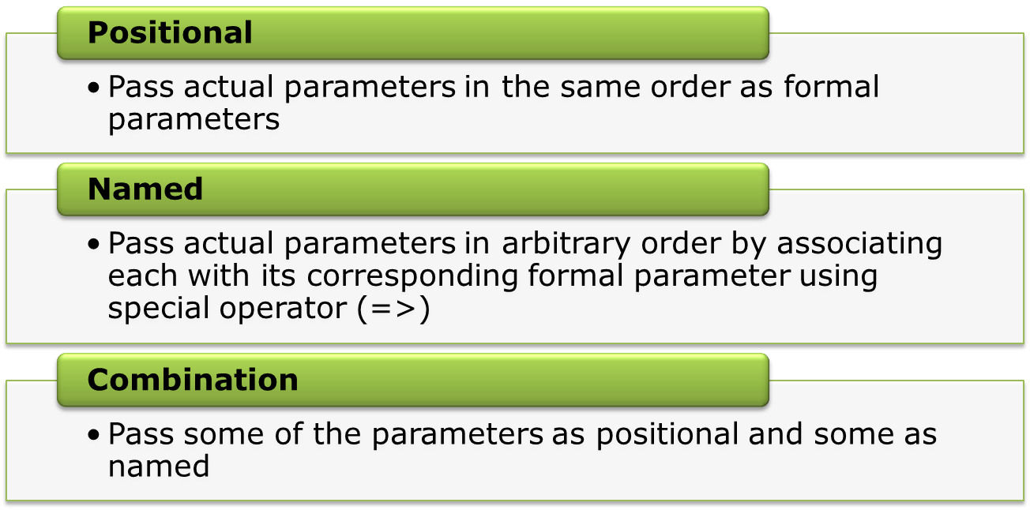
Methods of Passing Parameters
The various methods available for passing parameters to subprograms are:
While using combination, the positional parameters should be passed first

Slide 28
Methods of Passing Parameters: Example
CREATE TABLE cust AS
SELECT cust_name, cust_contact, cust_type
FROM customer where 1=2;
CREATE OR REPLACE PROCEDURE add_customer
(
p_cust_name IN customer.cust_name%TYPE
DEFAULT 'unknown',
p_cust_contact IN customer.contact%TYPE
DEFAULT 9890000000,
p_cust_type IN customer.cust_type%TYPE
DEFAULT ‘SILVER’)
IS
BEGIN
INSERT INTO customer (cust_name, cust_contact,cust_type)
VALUES( p_cust_name, p_cust_contact,p_cust_type);
COMMIT;
END add_customer;

Slide 29
Methods of Passing Parameters: Example
BEGIN
ADD_CUSTOMER ;
ADD_CUSTOMER ('SMITH', 9890222222,'SILVER');
ADD_CUSTOMER (p_cust_contact=> 9890111111,
p_cust_type=>'GOLD',
p_cust_name =>'STEVE');
ADD_CUSTOMER (p_cust_contact =>9890101010) ;
add_customer('MARK', p_cust_contact=> 9890112233,
p_cust_type=>'PLATINUM');
END;
SELECT * FROM cust;
Note: All the positional parameters should precede the named
parameters in a subprogram call.

Slide 30
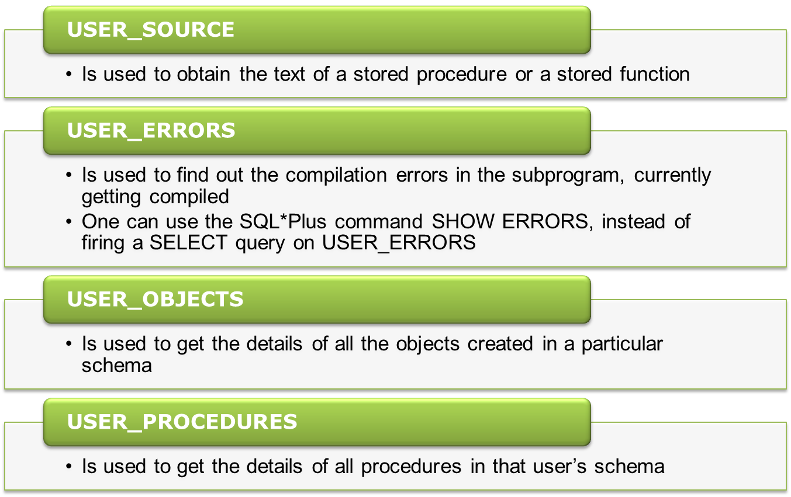
Data Dictionary View

Slide 31
Best Practices

Slide 32
Modularity
Improves code reusability
Hides the complexity of execution of a specific operation behind a name
Use top-down design to hide complexity
Notes:
A Package is a PL/SQL construct that allows related objects to be stored together
Groups together PROCEDURES, FUNCTIONS, CURSORS, types and variables
Other PL/SQL blocks can reference packages.
Advantages of Packages
Modularity: encapsulates logically related programming structures in a named module
Easier Application Design: initially only the interface information in the package specification is required
Information hiding: constructs can be public or private
Better Performance: when a packaged subprogram is called the first time, the entire package is loaded into memory
Overloading: packages allow you to overload procedures and functions
Overloading.-- Overload aggressively for smart packages. Overloading modules means that you create more than one program with the same name. Overloading transfers the burden of knowledge from the user to the software. You do not have to try to remember the different names of the modules and their specific arguments. Properly constructed, overloaded modules will anticipate the different variations, hiding them behind a single name, and liberate your brain for other, more important matters.
Restrictions on Overloading
Only local or packaged subprograms, or type methods, can be overloaded. You cannot overload standalone subprograms. If you try to
overload standalone procedures or functions, the latest definition simply overwrites the earlier one.
Packages: key PL/SQL building block-
Employ object-oriented design principles
- Build at higher levels of abstraction
- Enforce information hiding - control what people see and do
- Call packaged code from object types and triggers
Encourages top-down design and bottom-up construction
TD: Design the interfaces required by the different components of your application without addressing implementation details
BU: packages contain building blocks for new code
Organize your stored code more effectively
Implements session-persistent data

Slide 33
Modularity (Contd…)
Always:
    Reuse existing programs whenever possible
    Write tiny chunks (blocks) of code
    Build lots of Local or Nested Modules
    Avoid Spaghetti code
    Keep your executable sections small / tiny
Notes:
A Package is a PL/SQL construct that allows related objects to be stored together
Groups together PROCEDURES, FUNCTIONS, CURSORS, types and variables
Other PL/SQL blocks can reference packages.
Advantages of Packages
Modularity: encapsulates logically related programming structures in a named module
Easier Application Design: initially only the interface information in the package specification is required
Information hiding: constructs can be public or private
Better Performance: when a packaged subprogram is called the first time, the entire package is loaded into memory
Overloading: packages allow you to overload procedures and functions
Overloading.-- Overload aggressively for smart packages. Overloading modules means that you create more than one program with the same name. Overloading transfers the burden of knowledge from the user to the software. You do not have to try to remember the different names of the modules and their specific arguments. Properly constructed, overloaded modules will anticipate the different variations, hiding them behind a single name, and liberate your brain for other, more important matters.
Restrictions on Overloading
Only local or packaged subprograms, or type methods, can be overloaded. You cannot overload standalone subprograms. If you try to
overload standalone procedures or functions, the latest definition simply overwrites the earlier one.
Packages: key PL/SQL building block-
Employ object-oriented design principles
- Build at higher levels of abstraction
- Enforce information hiding - control what people see and do
- Call packaged code from object types and triggers
Encourages top-down design and bottom-up construction
TD: Design the interfaces required by the different components of your application without addressing implementation details
BU: packages contain building blocks for new code
Organize your stored code more effectively
Implements session-persistent data

Slide 34
Best Practice
A subprogram can be defined at any of these levels:
      Local - Within another Subprogram
      Private - Defined in the Package Body
      Public - Defined in the Package Specification
The best practice to follow is:
      Define subprograms as close as possible to their usage.
      The shorter, the distance from usage to definition, the easier it is to find, understand and maintain that code

Slide 35
Summary
In this session, we have covered:
Need for subprograms
Creating Stored Procedures
Invoking stored procedures from SQL*Plus and PL/SQL Block
Subprogram Parameter Modes – IN, OUT and IN OUT
Creating Stored Functions
Calling Stored Functions from different locations
Privileges related to functions and procedures
Dropping procedures and functions
Local Procedures and Functions within a stored subprogram
Methods of passing Parameters
Data dictionary views related to subprograms
  USER_OBJECTS
  USER_SOURCE
  USER_PROCEDURES
  USER_ERRORS

Slide 36
Thank You

